Slide 1
Machine Learning
9th May 2019
Kuan Sao I

Slide 2
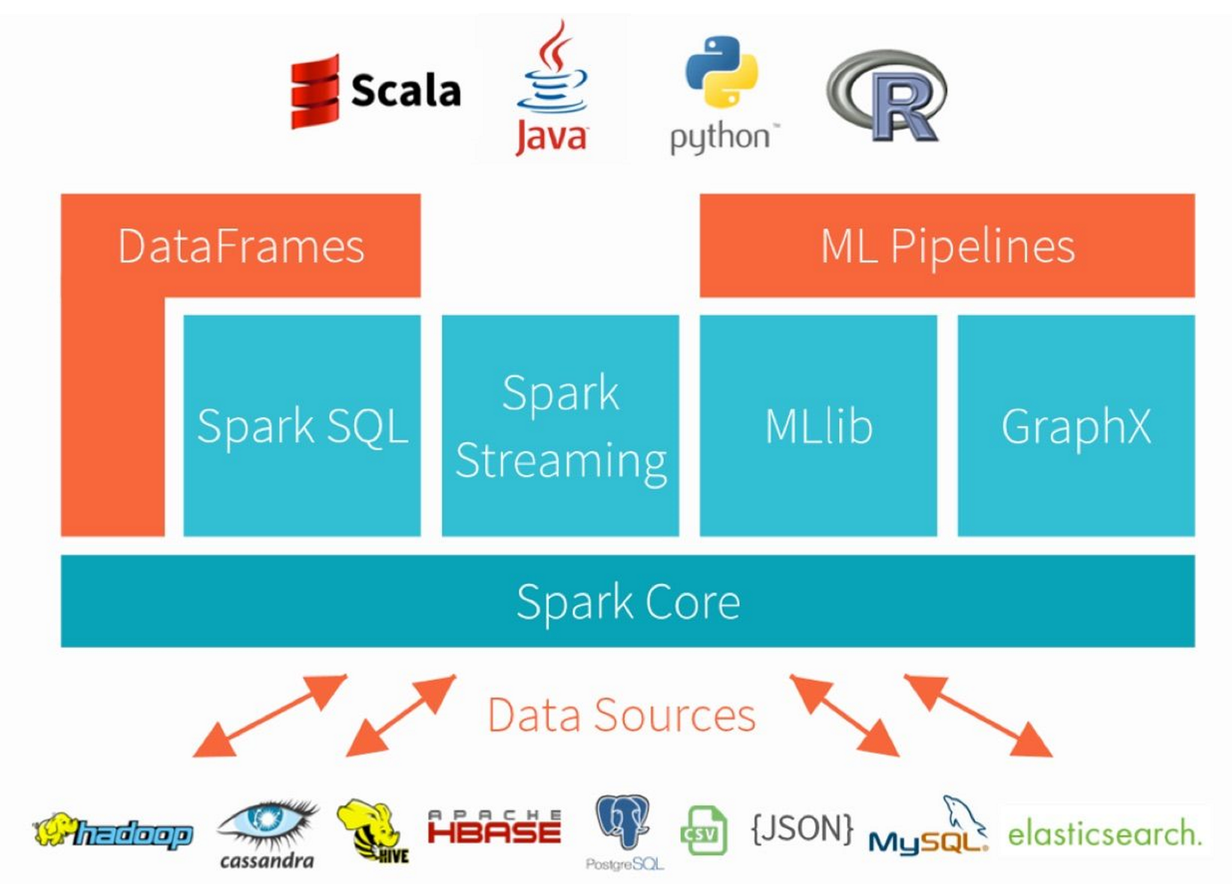
Content
Pyspark : MLlib vs ML package
Pyspark-example-ML-Airline
Pyspark vs Matlab
Example: ML - Airline
Scikit Learn
Pyspark vs Scikit Learn
Example: ML - Clustering
Furthermore
Streaming in Spark, Flink, Kafka
Deep Learning TensorFlow
Notes:
Flink
Kafka

Slide 3
1. Pyspark : MLlib vs ML package
MLlib
ML package
RDD
Data processing:
Feature extraction, transformation, etc.
Machine Learning Algorithm:
Regression, classification,etc.
Application
Descriptive statistic, chi-squared test, etc
DataFrame
Transformer :
VectorAssembler, HashingTF, etc
Estimator :
classification, regression, clustering, etc
Pipeline:
Transformer + Estimator
Notes:
Spark中ml和mllib的区别https://blog.csdn.net/u010159842/article/details/74784240

Slide 4
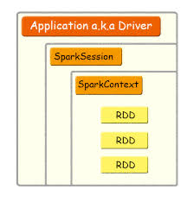
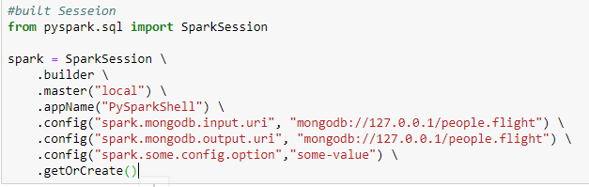
2. Pyspark-example-ML-Airline
Pyspark ML Package
Built Sesseion

Slide 5
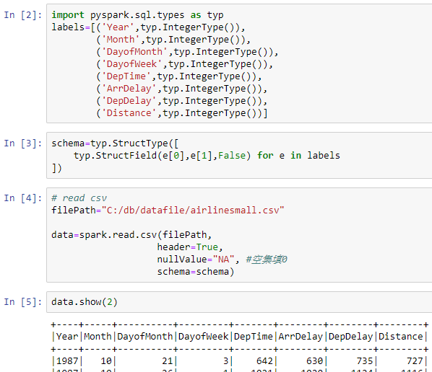
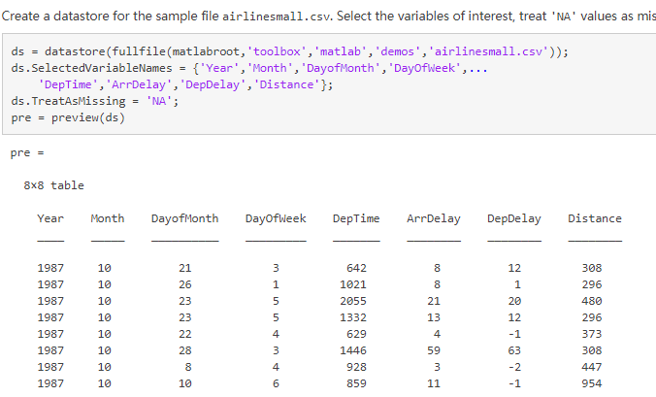
2. Pyspark-example-ML-Airline
Pyspark ML Package
Data preparing
Matlab

Slide 6
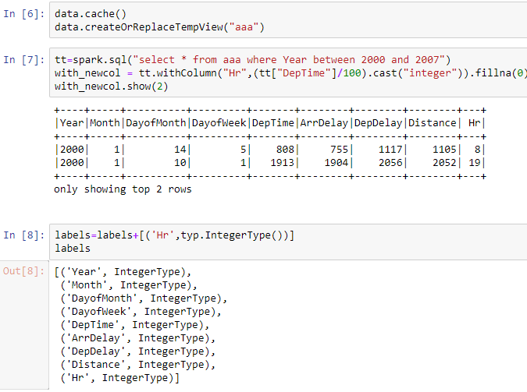
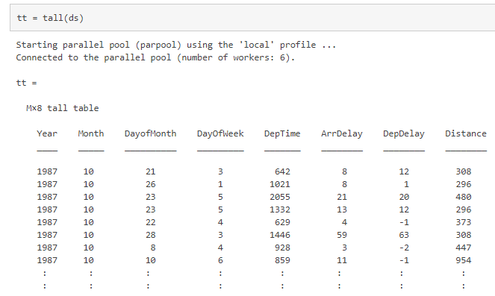
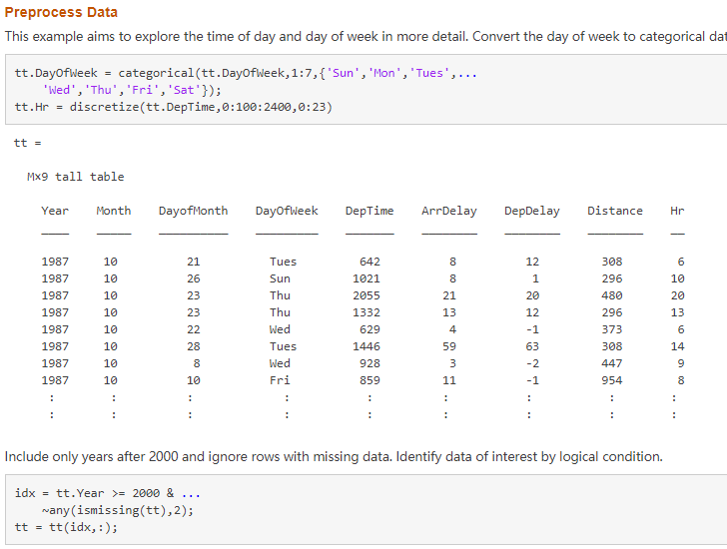
2. Pyspark-example-ML-Airline
Pyspark Sql query
Matlab tall array

Slide 7
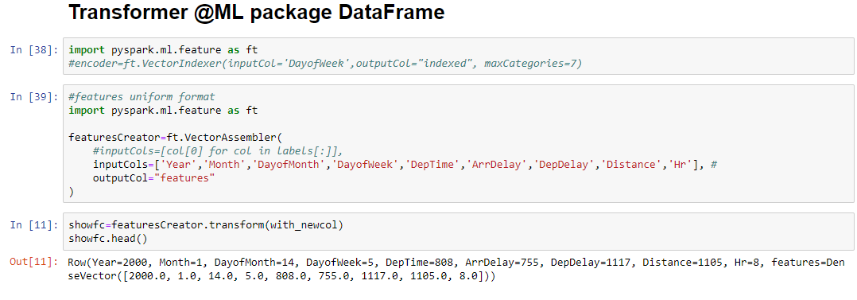
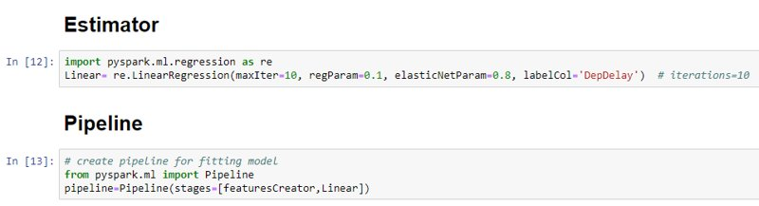
2. Pyspark-example-ML-Airline
Pyspark ML Package

Slide 8
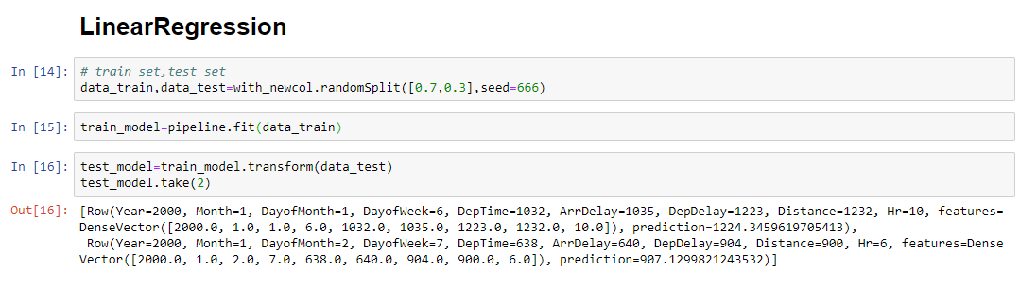
2. Pyspark-example-ML-Airline
Pyspark ML Package

Slide 9
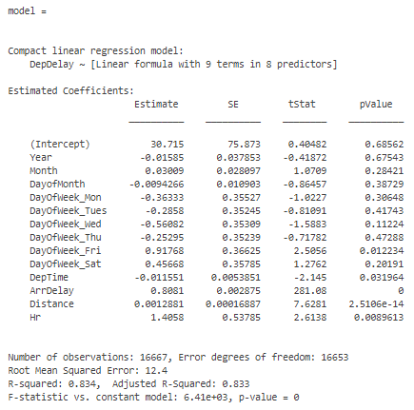
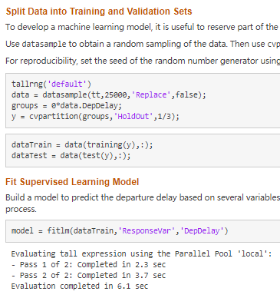
2. Pyspark-example-ML-Airline
Matlab

Slide 10
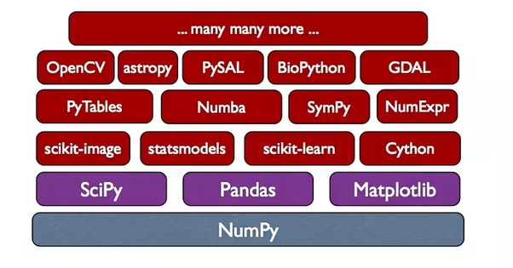
3. Scikit-learn
Scikit-learn is a free software machine learning library for the Python programming language.
Scikit-learn requires:
Python (>= 2.7 or >= 3.4),
NumPy (>= 1.8.2),
Numpy. Adds Python support for large, multi-dimensional arrays and matrices, along with a large library of high-level mathematical functions to operate on these arrays.
SciPy (>= 0.13.3).
SciPy is a collection of mathematical algorithms and convenience functions built on the Numpy extension of Python.
Notes:
Pandas. Software library written for data manipulation and analysis in Python. Offers data structures and operations for manipulating numerical tables and time series.

Slide 11
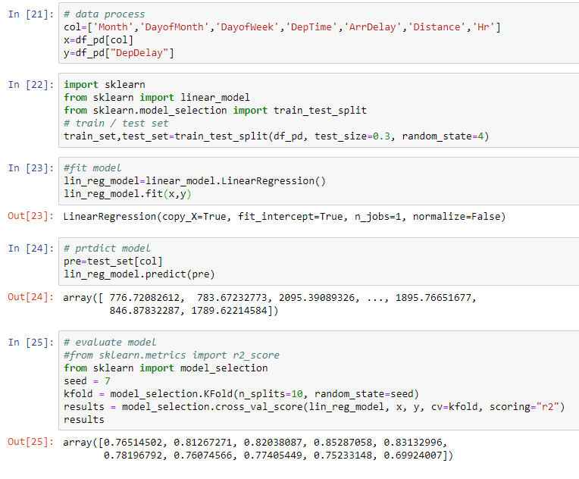
3. Scikit-learn
Data process
Fit model
Predict model
Evaluate model
Notes:
Pandas. Software library written for data manipulation and analysis in Python. Offers data structures and operations for manipulating numerical tables and time series.

Slide 12
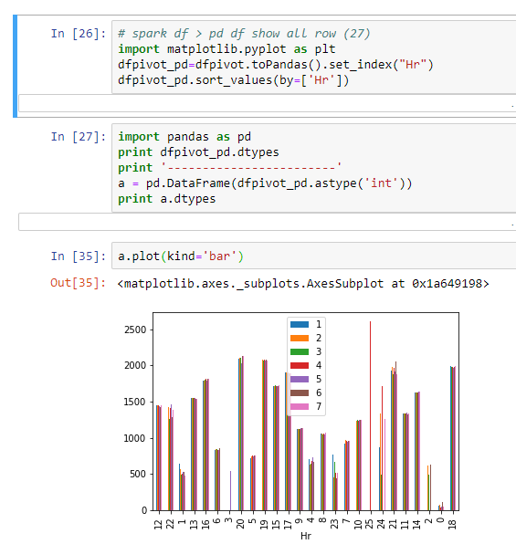
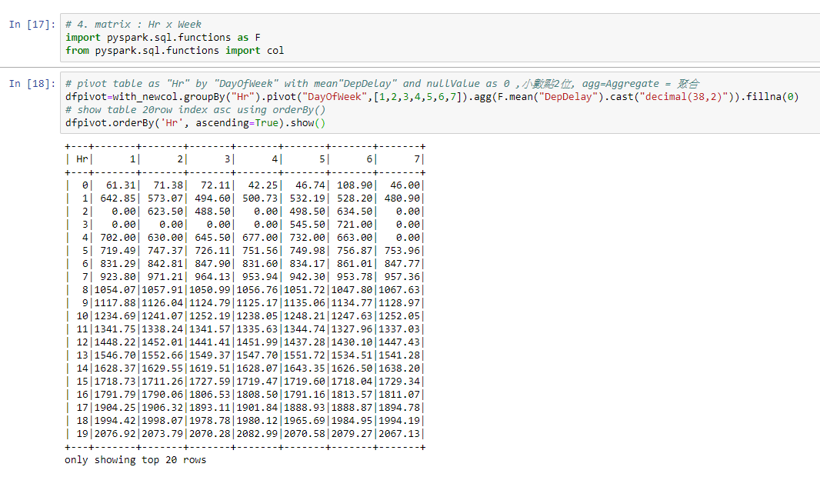
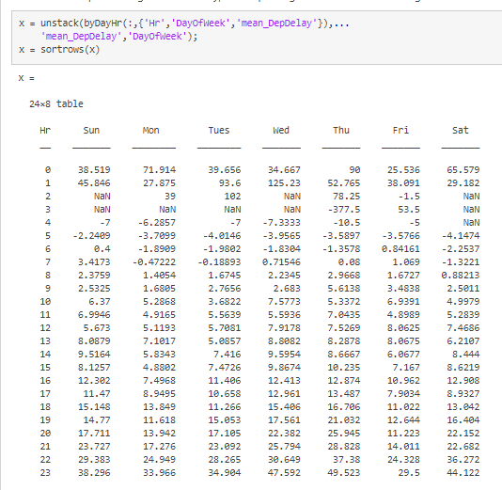
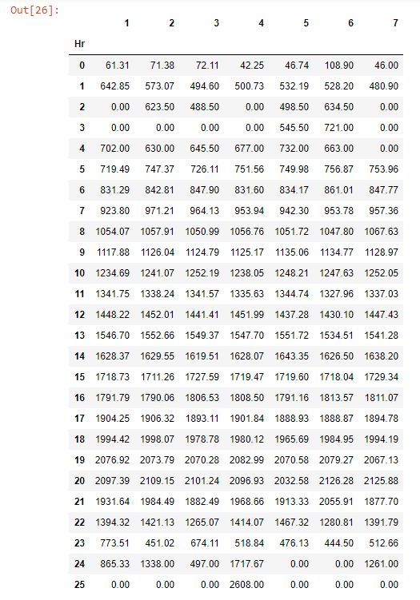
3. Scikit-learn
# Pyspark ML
# SK Learn
plot
# Matlab
Notes:
Pandas. Software library written for data manipulation and analysis in Python. Offers data structures and operations for manipulating numerical tables and time series.

Slide 13
3. Clustering – Data preparation
Scikit Learn
Matlab
# Generate data (swiss roll dataset)
n_samples = 1500 noise = 0.05 X, _ = make_swiss_roll(n_samples, noise,19) #<------------ _ xyz ge x, seed=19 # Make it thinner X[:, 1] *= .5
#<--------c *= a , c = c * a
Generate Swiss Roll Data
rng(10); % for reproducibility N = 1500; noise = 0.05; t = 3*pi/2 * (1 + 2*rand(N,1)); h = 11 * rand(N,1); X = [t.*cos(t), h, t.*sin(t)] + noise*randn(N,3);
'''​
_ 也可以在 交互模式interactive mode， 代表 上一行 的 結果。​
例如 ​
1.0/7​
0.14285714285714285​
_*2 會是​
0.2857142857142857​
'''

Slide 14
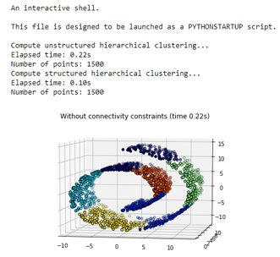
3. Clustering
Scikit Learn
print("Compute unstructured hierarchical clustering...") st = time.time() ward = AgglomerativeClustering(n_clusters=6, linkage='ward').fit(X) #<------ward 沃德法（Ward's method）：群聚間的距離定義為在將兩群合併後，各點到合併後的群中心的距離平方和 elapsed_time = time.time() - st label = ward.labels_ print("Elapsed time: %.2fs" % elapsed_time) print("Number of points: %i" % label.size)
# Plot result fig = plt.figure() ax = p3.Axes3D(fig) ax.view_init(7, -80) for l in np.unique(label): ax.scatter(X[label == l, 0], X[label == l, 1], X[label == l, 2], color=plt.cm.jet(np.float(l) / np.max(label + 1)), s=20, edgecolor='k') plt.title('Without connectivity constraints (time %.2fs)' % elapsed_time)

Slide 15
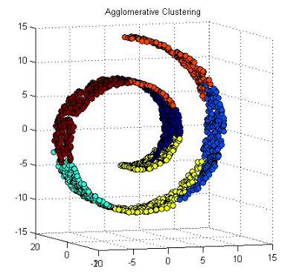
3. Clustering:
Matlab
figure('units','normalized','Position',[0.2 0.4 0.55, 0.35]), subplot(1,2,1)
c = clusterdata(X,'linkage','ward','maxclust',6);
# Plot result scatter3(X(:,1),X(:,2),X(:,3),[],c,'fill','MarkerEdgeColor','k'); view(-20,5) title('Agglomerative Clustering')
Notes:
https://ww2.mathworks.cn/products/demos/machine-learning/swiss_roll/swiss_roll.html

Slide 16
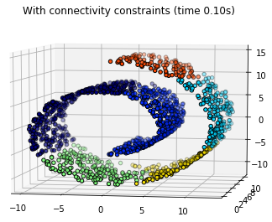
3. Clustering:
Scikit Learn
# Plot result
fig = plt.figure() ax = p3.Axes3D(fig) ax.view_init(7, -80) for l in np.unique(label): ax.scatter(X[label == l, 0], X[label == l, 1], X[label == l, 2], color=plt.cm.jet(float(l) / np.max(label + 1)), s=20, edgecolor='k') plt.title('With connectivity constraints (time %.2fs)' % elapsed_time) plt.show()
# Define the structure A of the data. Here a 10 nearest neighbors
from sklearn.neighbors import kneighbors_graph connectivity = kneighbors_graph(X, n_neighbors=10, include_self=False) #<----KNN
# Compute clustering
print("Compute structured hierarchical clustering...") st = time.time() ward = AgglomerativeClustering(n_clusters=6, connectivity=connectivity, linkage='ward').fit(X) elapsed_time = time.time() - st label = ward.labels_ print("Elapsed time: %.2fs" % elapsed_time) print("Number of points: %i" % label.size)

Slide 17
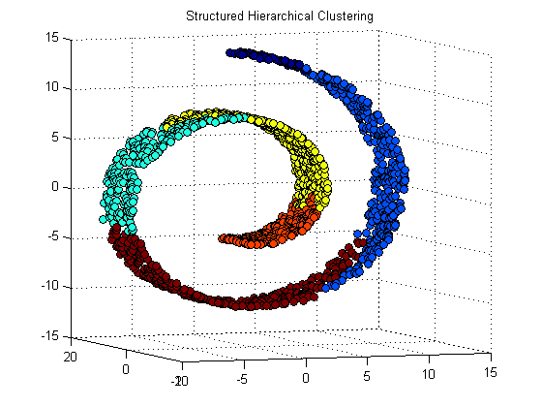
3. Clustering:
Matlab
Use Nearest Neighbors to Compute the Linkage
% Compute 40 nearest neighbors [idx,Dist]=knnsearch(X,X,'k',40); % Create the adjacency matrix for linkage D = zeros(size(X,1)); for ii = 1:length(X) D(ii,idx(ii,2:end)) = 1; end % Cluster the data with structure defined by neighbors cLinks = linkage(D, 'ward'); c = cluster(cLinks, 'maxclust', 6); % Visualize figure(2) scatter3(X(:,1),X(:,2),X(:,3),[],c,'fill','MarkerEdgeColor','k'); title('Structured Hierarchical Clustering') view(-20,5)

Slide 18
Summery
Degree of Freedom
Data process
Visualization
Algorithm
Compatibility
Table / Data Frame
Plot
Business
Open source
Enterprise

Slide 19
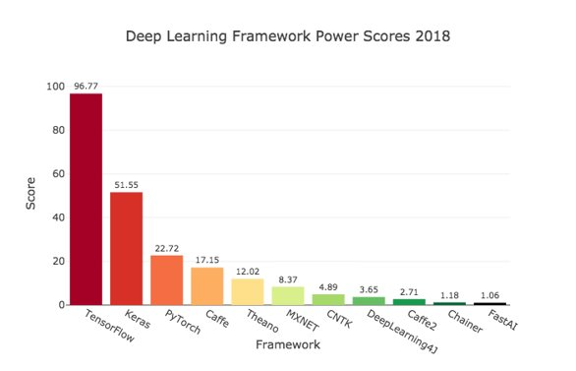
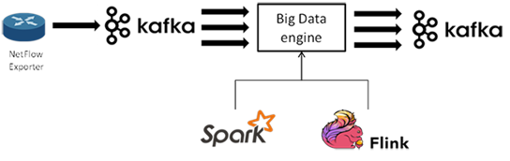
4. Furthermore
Deep Learning
TensorFlow, Keras, PyTorch
Streaming
Spark, Flink, Kafka

Slide 20


The End Thank you Machine Learning
9th May 2018
Kuan Sao I

